Slide 1
Properties of Gases and Gas Laws
ABDULLAHI Danjuma Kassim

Slide 2
Introduction - phases of matter
There are four major phases of matter:
solids,
liquids,
gases and
plasmas.
Starting from a solid at a temperature below its melting point, we can move through these phases by increasing the temperature.
First, we overcome the bonds or intermolecular forces locking the atoms into the solid structure, and the solid melts.

Slide 3
- phases of matter (Contn.)
At higher temperatures we overcome virtually all of the intermolecular forces and the liquid vapourises to form a gas (depending on the ambient pressure and on the phase diagram of the substance, it is sometimes possible to go directly from the solid to the gas phase in a process known as sublimation).
If we increase the temperature to extremely high levels, there is enough energy to ionise the substance and we form a plasma.
This course is concerned solely with the properties and behaviour of gases.
As we shall see, the fact that interactions between gas phase particles are only very weak allows us to use relatively simple models to gain virtually a complete understanding of the gas phase.

Slide 4
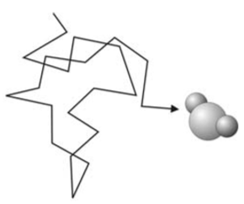
Characteristics of the gas phase
The gas phase of a substance has the following properties:
A gas is a collection of particles in constant, rapid, random motion (sometimes referred to as ‘Brownian’ motion). The particles in a gas are constantly undergoing collisions with each other and with the walls of the container, which change their direction − hence the ‘random’. If we followed the trajectory of a single particle within a gas, it might look something like the figure on the right.
A gas fills any container it occupies. This is a result of the second law of thermodynamics i.e. gas expanding to fill a container is a spontaneous process due to the accompanying increase in entropy.

Slide 5
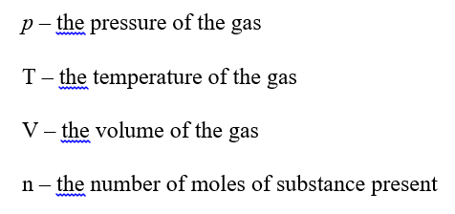
Characteristics of the gas phase
3. The effects of intermolecular forces in a gas are generally fairly small. For many gases over a fairly wide range of temperatures and pressures, it is a reasonable approximation to ignore them entirely. This is the basis of the ‘ideal gas’ approximation, of which more later.
4. The physical state of a pure gas (as opposed to a mixture) may be defined by four physical properties:

Slide 6
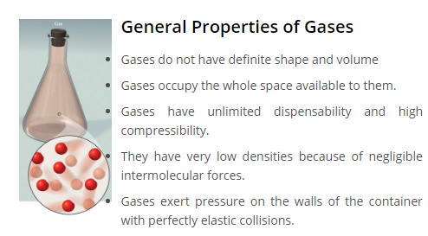
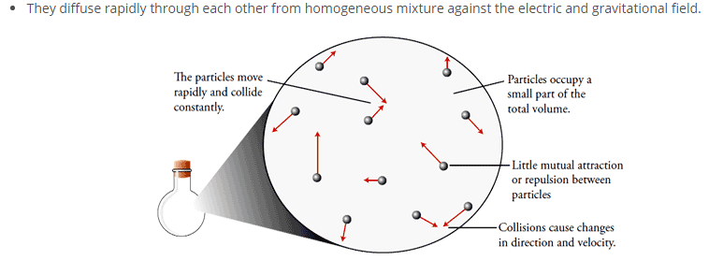

Slide 7
Parameters of Gases
The characteristics of gases are described in terms of following four parameters
Mass
Volume
Pressure
Temperature

Slide 8


1. Mass (M)
The mass of the gas is related to the number of moles as
n = w/M
Where n = number of moles
w = mass of gas in grams
M = molecular mass of the gas
2. Volume (V)
Since gases occupy the entire space available to them, therefore the gas volume means the volume of the container in which the gas is enclosed.
3. Pressure
Pressure of the gas is due to its collisions with walls of its container i.e. the force exerted by the gas per unit area on the walls of the container is equal to its pressure.

Slide 9

4. Temperature (T):
Temperature is defined as the degree of hotness. The SI unit of temperature is Kelvin. ºC and ºF are the two other units used for measuring temperature. On the Celsius scale water freezes at 0°C and boils at 100°C where as in the Kelvin scale water freezes at 273 K and boils at 373 K.

Slide 10
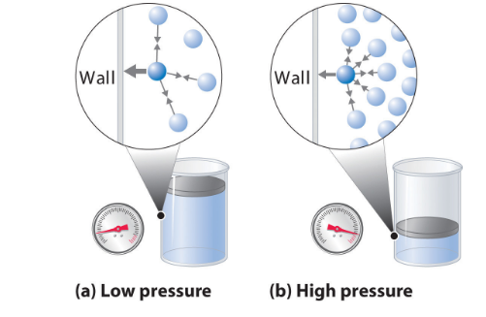
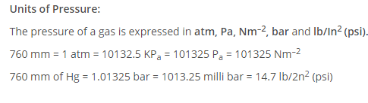
Pressure is exerted by a gas due to kinetic energy of its molecules.
As temperature increases, the kinetic energy of molecules increases, which results in increase in pressure of the gas. So, pressure of any gas is directly proportional to its temperature.

Slide 11
4. Temperature (T):
Temperature is defined as the degree of hotness. The SI unit of temperature is Kelvin. ºC and ºF are the two other units used for measuring temperature. On the Celsius scale water freezes at 0°C and boils at 100°C where as in the Kelvin scale water freezes at 273 K and boils at 373 K.

Slide 12
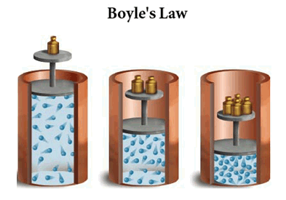
Gas Laws
Boyle’s Law
In 1662, Robert Boyle discovered that there existed a relation between the pressure and the volume of a fixed amount of gas at a fixed temperature. In his experiment, he discovered that the product of Pressure & Volume of a fixed amount of gas at a fixed temperature was approximately a constant. So, Boyle’s low states that
”At constant temperature, the pressure of a fixed amount (i.e., number of moles n) of gas varies inversely with its volume”.

Slide 13
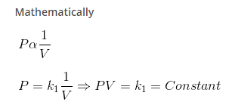


Boyle’s Law (Cont.)
It means that at constant temperature, product of pressure and volume of a fixed amount of gas is constant.
If a fixed amount of gas at constant temperature T occupying volume V₁ at pressure P₁ undergoes expansion, so that volume becomes V₂ and pressure becomes P₂,

Slide 14


Slide 15
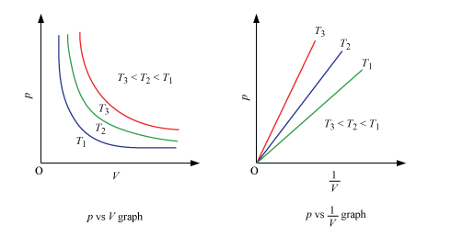
Graphical Representation of Boyle’s Law :
A plot of P versus 1/V at constant temperature for a fixed mass of gas would be a straight line passing through the origin.
A plot of P versus V at constant temperature for a fixed mass of a gas would be a rectangular hyperbola.

Slide 16
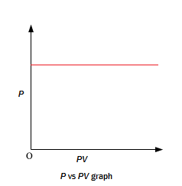
A plot of P (or V ) versus PV at constant temperature for a fixed mass of a gas is a straight line parallel to the PV axis.

Slide 17
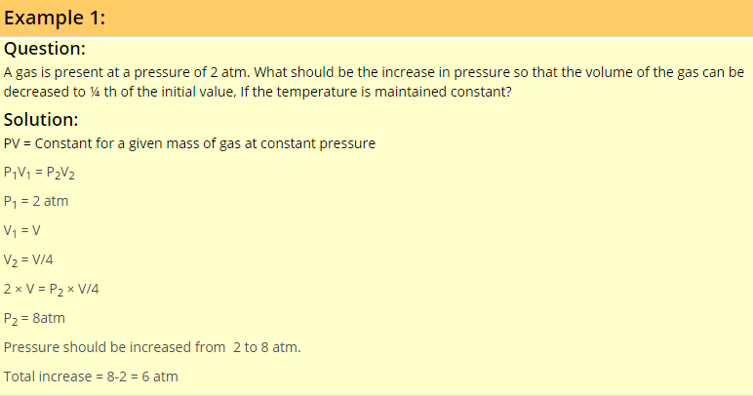

Slide 18
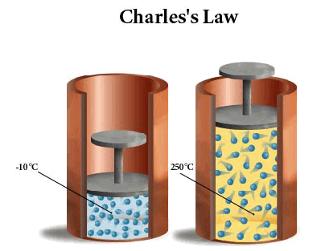
Charles’s Law
In 1787, Jacques Charles discovered that if the pressure is kept constant, the volume of a gas sample increases linearly with the temperature for a fixed amount of gas. This law led to the idea of temperature. The unit of temperature used is Kelvin. Charles’s law states that
”At constant pressure, the volume of a given mass of a gas is directly proportional to its absolute temperature”

Slide 19
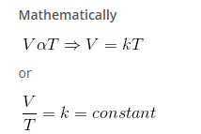
Hence, if at constant pressure the volume of a gas V₁ at temperature T₁ change to V₁ at T₂ we have

Slide 20

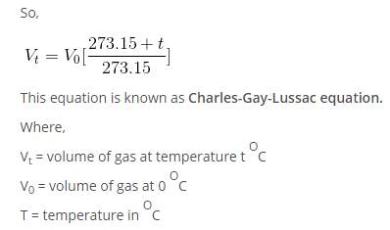
This equation is known as Charle’s Law equation or formula.
For each degree change in temperature, the volume of sample of a gas changes by the fraction of 1/273.5 of its volume at 0 ºC.

Slide 21
The temperature of -273 ^{O}C, at which the volume of a gas would theoretically be reduced to zero, is called absolute zero. At absolute zero temperature, the volume, pressure, kinetic energy and heat content of a gas is zero.

Slide 22
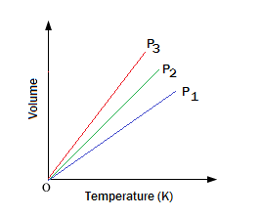
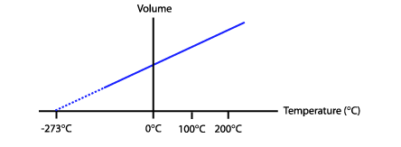
Graphical Representation of Charles’s Law :
1. For a definite mass of the gas a plot of V vs T (ºK) at constant pressure is a straight line passing through the origin.
2. A plot of V vs t (ºC) at constant pressure is a straight line cutting the temperature axis at -273 ºC

Slide 23
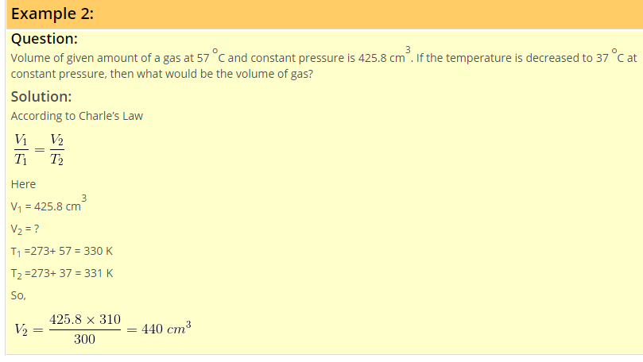

Slide 24
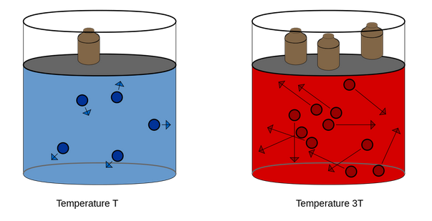
Gay-Lussac’s Law or Amonation’s Law
This law states that “at constant volume, the pressure of a given mass of a gas is directly proportional to its absolute temperature”.

Slide 25
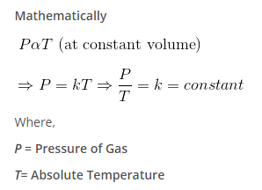
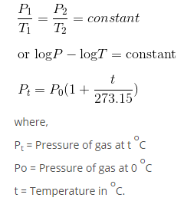
If the pressure and temperature of a gas changes from P₁ & T₁ to P₂ & T₂ , volume remaining constant , we have

Slide 26
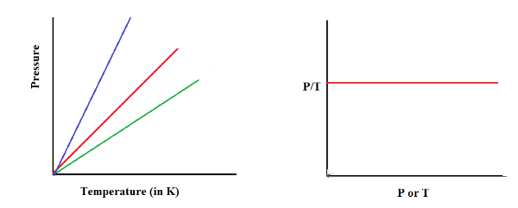
Graphical Representation of Gay-Lussac’s Law

Slide 27
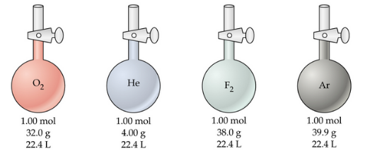
Avogadro’s Law
In 1812, Amadeo Avogadro stated that
“Samples of different gases which contain the same number of molecules (any complexity, size, shape) occupy the same volume at the same temperature and pressure”.

Slide 28

It follows from Avogadro’s hypothesis that (when T and P are constant).

Slide 29
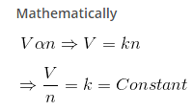
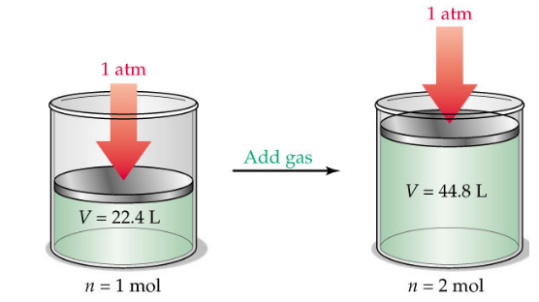

Slide 30
Since volume of a gas is directly proportional to the number of moles; one mole of each gas at standard temperature and pressure (STP) will have same volume. Standard temperature and pressure means 273.15 K (0°C) temperature and 1 bar (i.e., exactly 105 pascal) pressure. At STP molar volume of an ideal gas or a combination of ideal gases is 22.71098 L mol^{–1}
We know that number of moles of any gas (n) = m/M
Where m = mass of the gas under investigation and M = molar mass.
So, we can conclude from equation that the density of a gas is directly proportional to its molar mass.
A gas that follows Boyle’s law, Charles’ law and Avogadro law strictly is called an ideal gas. Such a gas is hypothetical. It is assumed that intermolecular forces are not present between the molecules of an ideal gas. Real gases follow these laws only under certain specific conditions when forces of interaction are practically negligible.

Slide 31
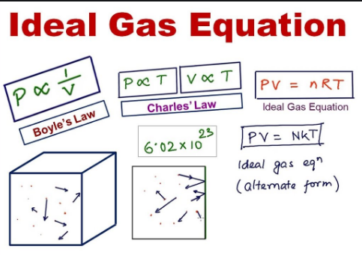
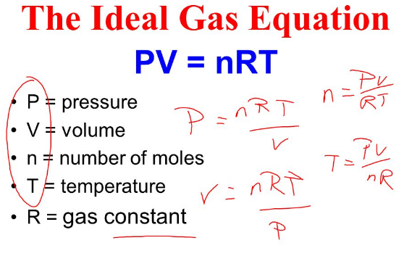
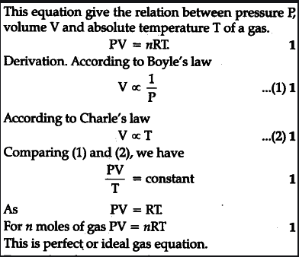

Slide 32
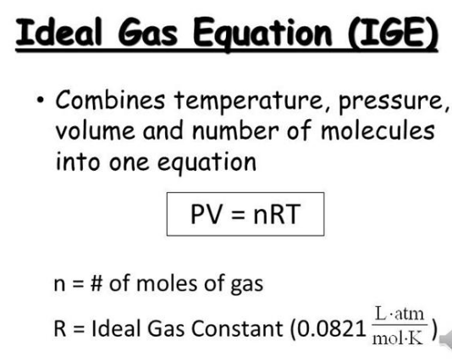
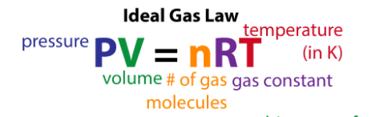

Slide 33
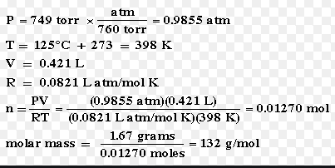
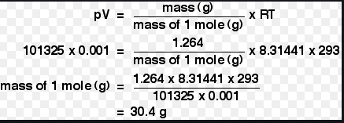
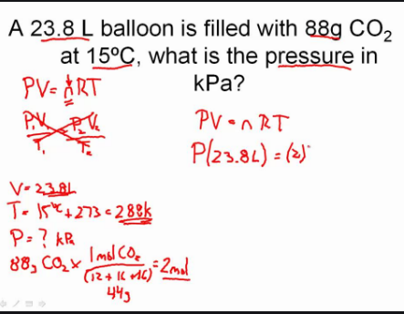

Slide 34
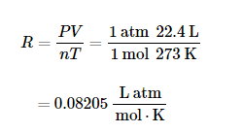
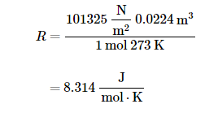
The Gas Constant R
Repeated experiments show that at standard temperature (273 K) and pressure (1 atm or 101325 N/m²), one mole (n = 1) of gas occupies 22.4 L volume. Using this experimental value, you can evaluate the gas constant R,
When SI units are desirable, P = 101325 N/m² (Pa for pascal) instead of 1 atm. The volume is 0.0224 m³. The numerical value and units for R are

Slide 35
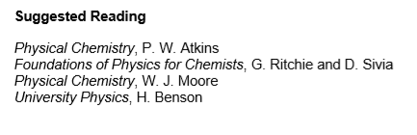

Slide 36

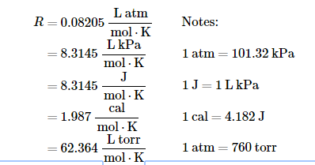
Since energy can be expressed in many units, other numerical values and units for R are frequently in use.
For your information, the gas constant can be expressed in the following values and units.

Slide 37
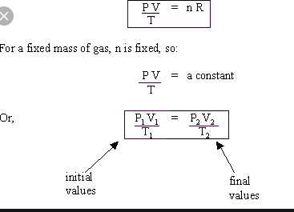
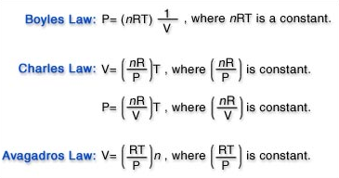
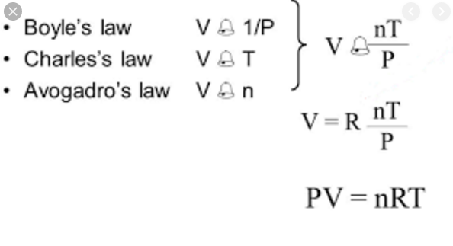

Slide 38
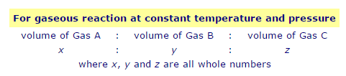
Gay-Lusac's Law of Combining Gas Volumes
Gay-Lusac's Law of Combining Gas Volumes states that:
The volume of gases taking part in a chemical reaction show simple whole number ratios to one another when those volumes are measured at the same temperature and pressure.
When gas A reacts with gas B to produce gas C at constant temperature and pressure, then the ratio of the gas volumes will be a simple whole number ratio:

